Slide 1

Heat Transfer
I Like it Hot!!

Slide 2
Learning Objectives
I can describe what heat is.
I can explain the direction in which heat flows.
I can describe the differences in transferring heat by conduction, convection, and radiation.
I can describe the difference between an insulator and a conductor.
Notes:
In this lesson, students will learn the definitions of both potential and kinetic energy. They will also be able to give examples of each and explain how potential energy changes into kinetic energy.

Slide 3
Heat and how it moves
Define “Heat”:
The transfer of thermal energy from 1 object to another because a difference in temperature.
Heat moves from a substance with a higher temperature to another substance with a lower temperature.

Slide 4
Question
Q: If a cup of hot chocolate and an ice cube were left on the table in this room what would happen to their Temperature? Why?
A: The cup of hot chocolate will cool until it reaches “room temperature.”
A: The ice cube will melt and then the liquid will warm to “room temperature.”
(Room temperature is about 25 Degrees C)

Slide 5

Heat Transfer
Heat always moves from a warmer place to a cooler place.
So:
  Hot objects in a cooler room will cool to room temperature.
Heat Energy
Heated liquid/air
Cooler air
The cooler air warms up and the mug cools
down until both are about equal temperature
The air outside the mug is cooler
than the air inside the mug. So the heated air
moves out of the mug into the cooler air

Slide 6
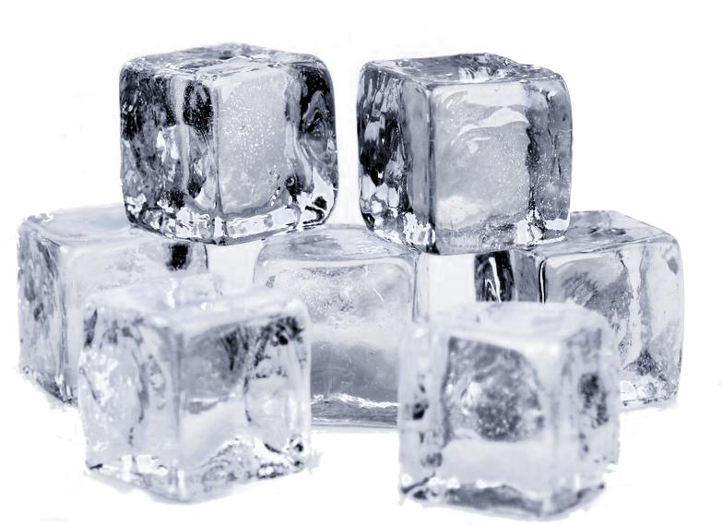
Heat Transfer
Heat always moves from a warmer place to a cooler place. So:
  Cold objects in a warmer room will heat up to room temperature.
Heat Energy
All solids (ice) melt when they
gain enough heat energy

Slide 7
The Nature of Heat
Heat moves in only one direction:
Under normal conditions and in nature, heat energy will ALWAYS flow from the warmer object to the cooler object.
Heat energy will flow from one substance to another until the two substances have the same temperature. This is known as Thermal Equillibrium

Slide 8
Heat Transfer Methods
Heat moves from one place to another by:
  Conduction: Movement through direct contact.
  Convection: Circular motion of heated fluid material.
  Radiation: Light waves through a space or gas.

Slide 9
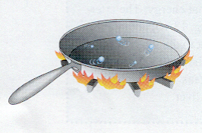
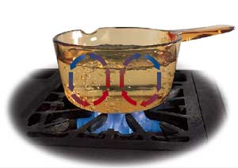
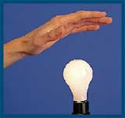
Conduction
Convection
Radiation

Slide 10
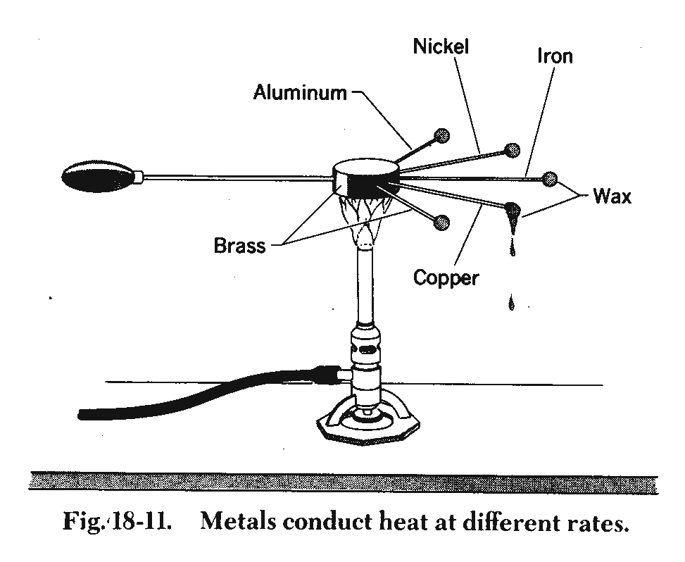
Conduction
The transfer of thermal energy (heat) from within a material or between materials that are touching or from one particle of matter to another by direct particle to particle contact.

Slide 11
Conduction
What state of matter does conduction usually take place in and why?
  Conduction occurs primarily in solids because the particles are tightly packed together so they can touch each other.
  The particles themselves DO NOT change positions.

Slide 12
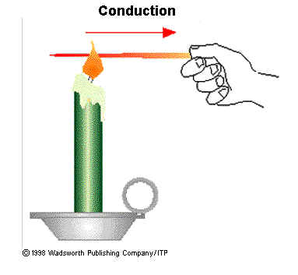


CONDUCTION
When you heat a metal strip at one end, the heat travels to the other end.
So it’s no wonder that you can hold metal
over a flame without it burning your hand for
a few seconds, but after that…OUCH!!!
Metal Bar
Watch as the atoms closest to the
flame gain more energy first and
the energy simply spreads out
Heat Energy
It takes a little time, but the Heat
Energy spreads out and the
metal gets “hotter”
As you heat the metal, the atoms vibrate faster, these vibrations make the adjacent atoms vibrate, and so on and so on, the vibrations are passed along the metal and so is the heat.

Slide 13
Why Metals heat up so fast?
In addition to atom vibrations, the electrons for metal atoms can “drift”; are free to move around within the metal.
= electron
When the metal is heated, the electrons gain kinetic energy and transfer it throughout the metal.
Heat
Energy
“Insulators”, such as wood and plastic, do not have drifting electrons which is why they do not conduct heat as well as metals.

Slide 14

Why does metal feel colder than wood, if they are both at the same temperature?
Metal is a conductor, wood is an insulator. The metal conducts the heat away from your hands, the wood does not conduct the heat away from your hands as well as the metal, so the wood feels warmer than the metal.
The hand holding the metal is losing heat
to the metal so it feels cooler!

Slide 15
Convection
Convection: the transfer of thermal energy (heat) when particles of fluid move from 1 place to another or through the bulk movement of matter.
  Convection occurs in FLUIDS (liquids and gases).
  Convection produces CURRENTS in both gases and liquids.
  Thermal Energy heat is carried by the particles as they move from one location to another.

Slide 16
CONVECTION
= “hot” atom
= “cool” atom
Cooler, more dense liquids
and gases (fluids) sink (move down).
Warmer, less dense liquids and gases (fluids) spread out and rise up.

Slide 17
Convection: Movement of Heat in a “circular” motion
That’s why its called a “Convection Current!”
How does this work in a liquid?
A “current” is a “steady flow” of a “fluid” (liquid and gas)
Hot water rises
Warms back up again.
Cools at the surface
Hot water rises back up
Cooler water sinks
Heat source
Demo: Oil & Thyme

Slide 18
Cold air sinks
Where is the freezer compartment put in a fridge?
Freezer compartment
It is warmer at the bottom, so this warmer air rises and a “convection current” begins.
It is put at the top, because cool air sinks, so it cools the food on the way down.

Slide 19
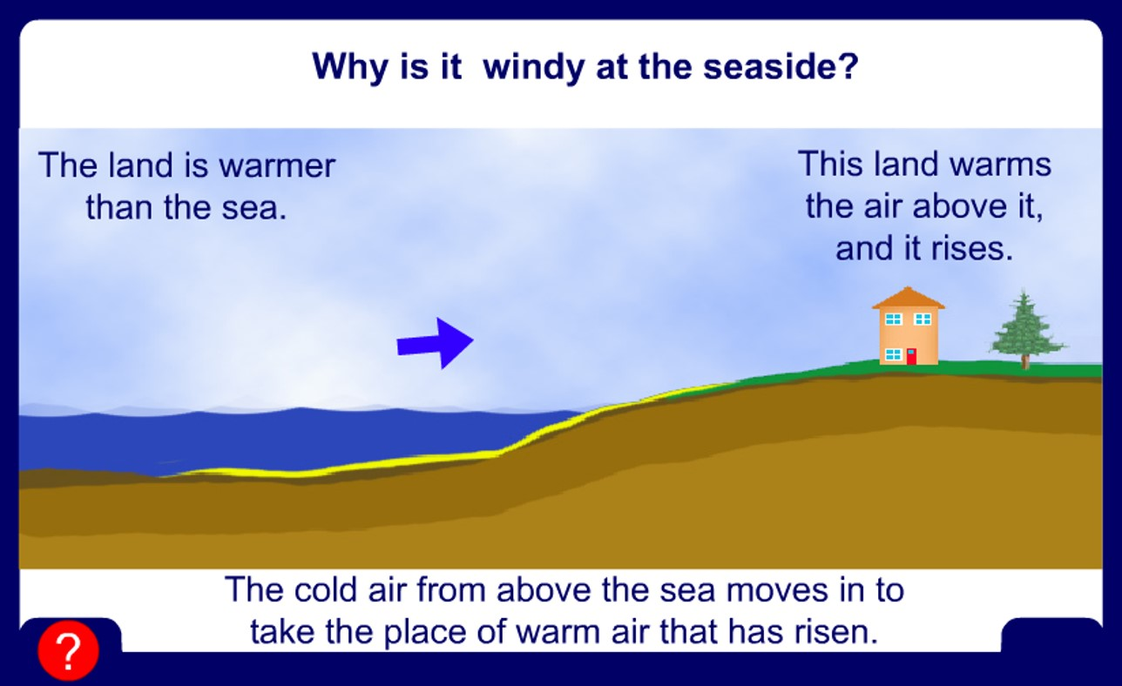
Why is it windy at the seaside?
So it moves sideways towards the shore and we feel this motion as a breeze
When the cool air reaches the surface of the water, there is nowhere else for it to go
And we get convection currents of air!
As the cool breeze reaches the land, it heats up, and rises as well!

Slide 20
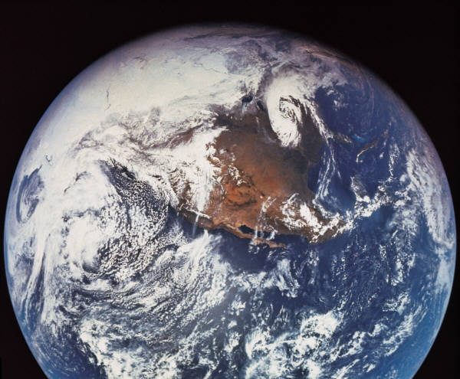

Convection
Convection currents occur in the environment as well. They produce:
  Global winds that contribute to Earth’s weather.
  Ocean and lake currents

Slide 21
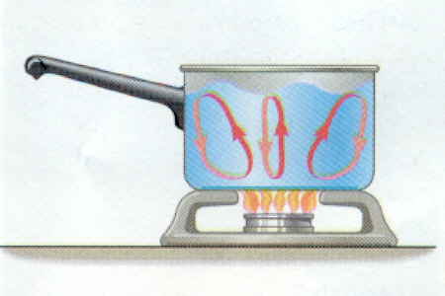
Convection

Slide 22
Convection
Application: How do convection currents form in room when the heater is turned on?
The warm air from the heater vent will rise. Why?,
  The warm air is less dense than the surrounding cooler air.
The cool air is pushed down by the rising warm air.
What is the best location for a heat vent in a room and why? Near the ceiling or the floor?
Floor:
Because the warm air will rise to the ceiling.
How about the return vent?

Slide 23

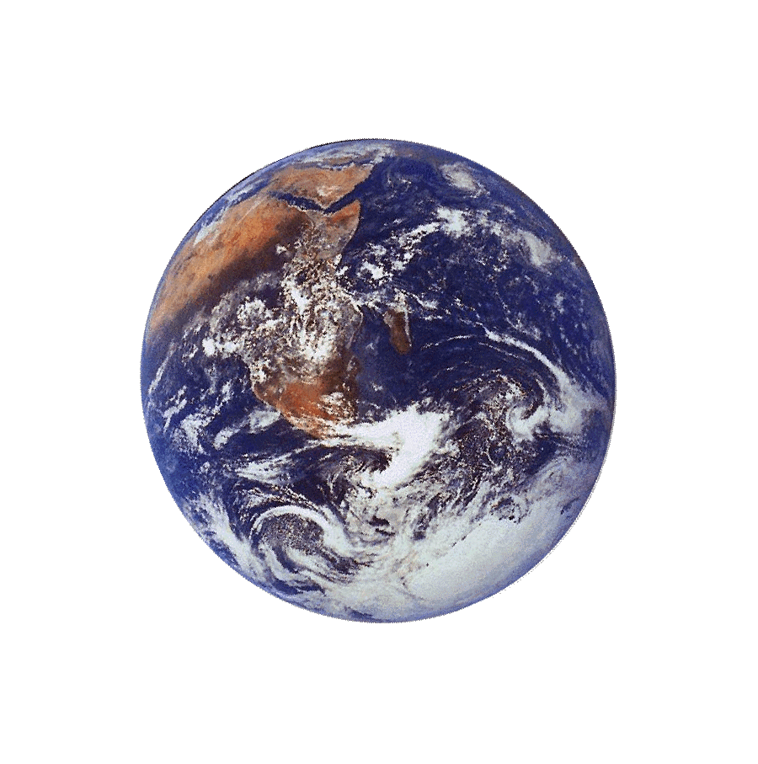
The third method of heat transfer: Radiation
How does heat energy get from the Sun to the Earth?
There are no atomic particles between the Sun and the Earth so it CANNOT travel by conduction or by convection.
?
RADIATION=The transfer of heat by electro-magnetic waves!
Also Known as “Light!”

Slide 24
Radiation
Radiation: the transfer of (thermal) energy by electromagnetic waves.
  Radiation does not require matter to transfer thermal energy.
    All the sun’s energy that reaches Earth travels through millions of kilometers of empty space (a vacuum).
  All matter can radiate energy.
    You feel the radiation of thermal energy from a bonfire, a heat lamp and a light bulb.

Slide 25
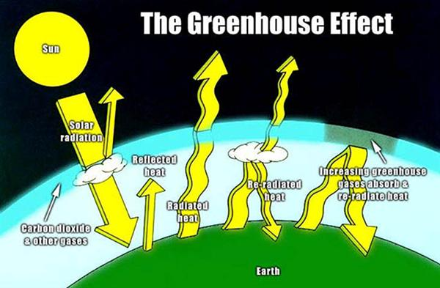
Radiation helps keep our planet warm
But some of it escapes back out into
Space = planet doesn’t warm up too much!
Notice that some of the heat gets “trapped” by
the atmosphere and stays here = planet stays warm!

Slide 26
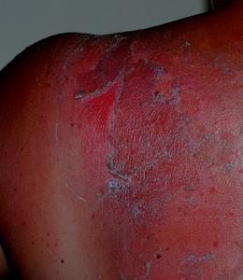
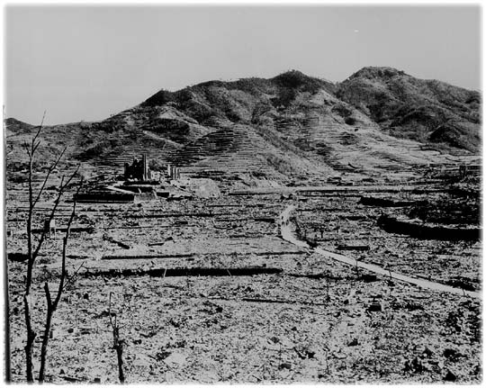
There is a lot of energy in Solar Radiation:
After the atomic bomb in Japan. There was
once a large city where this photo is looking.
Now it is completely destroyed!!!
(it only took about 1 second!!!)
Much of this destruction was caused by
radiation
Sunburns are because of
Radiation impacting our skin
There was so much Radiation energy
when the bomb blew up that some people
were simply vaporized!!! YIKES!!!

Slide 27
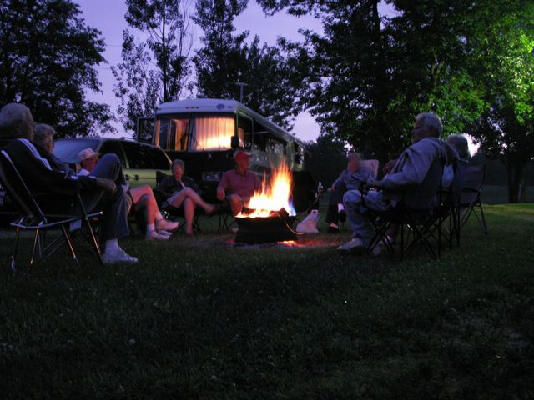
Human Uses for Radiation:
There are some great uses for Radiation;
You can also use radiation to get warm on a camping trip! Or to cook food with a microwave:

Slide 28
Radiation
Key Point: For radiation to be felt as heat it must first be absorbed by a material.
Example: Why do blue jeans feel hotter in the sun than a yellow shirt, even though they are both exposed to the same amount of sunlight?
  The blue jean fabric absorbs more radiant energy from the sun than the yellow shirt because of its dark color.

Slide 29
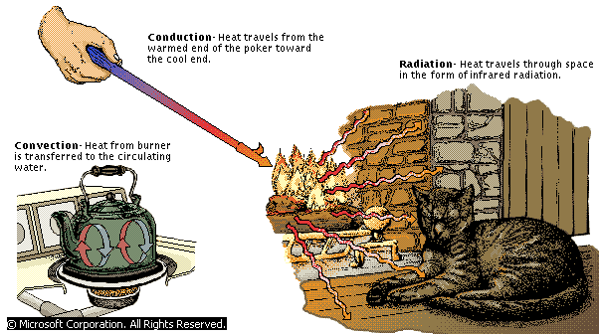
Conduction, Convection & Radiation

Slide 30
Contrast:
Conduction
Convection
Radiation
Direct contact of particles
Solids/liquids/gases
Solids -good conductors
Gases -poor conductors
Conduction
Transfer of energy by waves
Only radiant energy that is absorbed becomes thermal energy
Shiny/light colors- reflect
Dull/dark colors-absorb
Transfer of energy by bulk movement of matter (fluids)
Currents (wind,water)
Hot air balloon
Radiation
Convection

Slide 31
Big Ideas
Heat is the transfer of thermal energy from 1 object to another because a difference in temperature.
Heat flows from hot to cold.
3 types of heat transfer
- Conduction – Movement by direct contact.
- Convection – Circular motion of heated fluid material due to differences in density
- Radiation – transfer of thermal energy by waves through space.

